Slide 1
Hybrid Assesment
Using formative tools to evaluate your summative test
Theo Roos

Slide 2
Short point to open with
I am a teacher, no researcher.
Not based on solid research, but based on what I do in classroom
Just telling what I do and what I see

Slide 3
Evaluating a summative test
Students made a test, you graded the test, giving back the results and want to evaluate the test together with the class
What is your experience?
Looking for somebody withe the same color of shirt, share your experiences in duo’s or trio’s
Maybe one of the most disappointing moments in teaching.

Slide 4


Evaluating a summative test
Do you recognize this?

Slide 5


My experience
Students are quickly satisfied.
A few students only pay attention to get more points
Same mistakes are made
in the next test
I thougt: “This has to change”.

Slide 6
Evaluating a summative test
What did I see?
Lack of envolvement
Does not contribute to the learning proces

Slide 7

Evaluating a summative test
How do you do the evaluation process?
Are students bored, and if yes, why?
Grades do not motivate!!! (Dylan William,2017)

Slide 8
Why do we still give summative tests
Determination
Proceed to the next year
Getting a degree or certificate
Evaluate the functioning of the theacher
Assessment of the school (Onderwijsraad, 2018)
So we are bound to summative testing

Slide 9
Finding tools to evaluate a summative test
Two questions
  How to envolve students?
  How to enhance the learning process?

Slide 10
How to envolve students?
How do we define envolvement (Guidone, 2018)?
  Behavioural envolvement
    Being in time, being present, sticking to the rules, participating in class
  Emotional envolvement
    Enthousiastic about school, feeling at home, feeling safe
  Cognitive envolvement
    Knowing the importance of the course or education, committed to get good results, understanding the subjects.
  Which of the three you see the less with your students?
  In my classes there was a lack of cognitive envolvement

Slide 11

Cognitive envolvement
I read this book, was in the States
at a conference and followed two
workshops

Slide 12
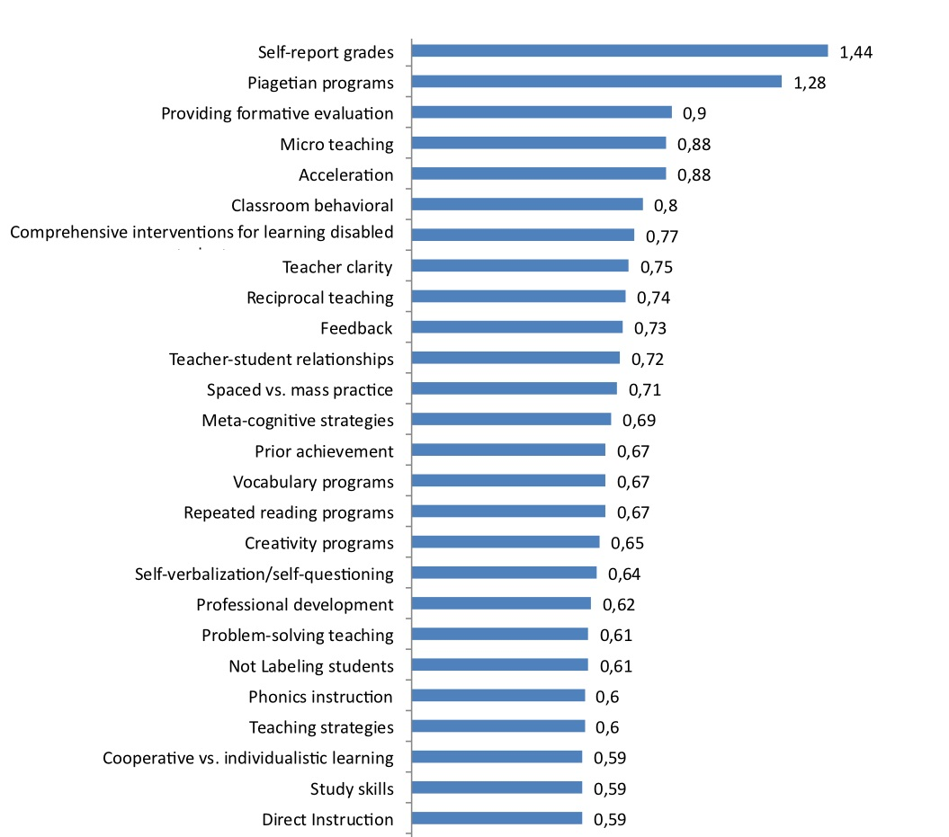
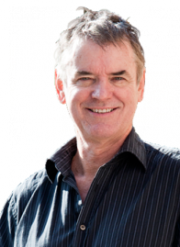
How to enhance the learning process?
John Hattie combined around 50,000 educational researches to
come to over 1,000 meta- analyses.
240,00,000 students were participating in the researches.
His research is aimed on how to enhance the learning process.
Which intervention has the most effect on the learning of a student.
3. Providing formative evaluation (Hattie, 2017)
Giving and getting information about the learning process to enhance learning and teaching (Wiliam, Cijfers geven werkt niet, 2016).

Slide 13
How to enhance the learning process?
10. Feedback
John Hattie about feedback:
We look at test results as feedback of our impact.
Feedback is not one thing, it is a process
Feed up (Where are you going [learning goals]?)
Feed back (Where are you now [results]?)
Feed forward (where are you going? [what to do])

Slide 14
A lesson plan voor test evaluation?
In the basis no difference with a normal lesson
Setting goals
  Be aware that most of the times a test is not the end of learning but part of the learning process
Sharing knowledge
Assigning a task
Check your goals

Slide 15
So, what do I do?
Setting goals
  Showing them their way into the final exams. What do they need to know and when, why and where to use this evaluation. FEED UP
Sharing knowledge and assigning a task
  The task includes sharing knowledge
Check your goals
  Check the student’s progress

Slide 16
My solutions does not have to be yours
I grade tests and do not write any clues
or grades on the test
Students get back a non graded test
I use a correction model to go trhough
the test with students
Students grade their own test
Students can earn a small bonus

Slide 17
My solutions does not have to be yours
I grade tests and do not write any clues or grades on the test
Students get back a non graded test I use a correction model to go trhough
the test with students
Students grade their own test and define why their answer is not the right one
  Identifying simularities and differences (academic) and note taking
Students can earn a small bonus
  (PERSONAL RESPONSE)
After the test students get their own feed back form
  (FEED BACK)

Slide 18
My solutions does not have to be yours
I grade tests and do not write any clues or grades on the test
Students get back a non graded test I use a correction model to go trhough
the test with students
Students grade their own test and define why their answer is not the right one Identifying simularities and differences (academic) and note taking
Students can earn a small bonus Leerlingen krijgen een persoonlijk feedback formulier. (PERSONAL RESPONSE)
After the test students get their own feed back form (FEED BACK)
Students compare their score with the one I gave them
  Analyse and evaluate

Slide 19
My solutions does not have to be yours
I grade tests and do not write any clues or grades on the test
Students get back a non graded test I use a correction model to go trhough
the test with students
Students grade their own test Identifying simularities and differences (academic) and note taking
Students can earn a small bonus Leerlingen krijgen een persoonlijk feedback formulier. (PERSONAL RESPONSE)
After the test students get their own feed back form (FEED BACK)
Students compare their score with the one I gave them (Analyse and evaluate).
I tell students how they can use this feedback form in preparing their next test
  (FEED FORWARD)

Slide 20
Cognitive envolvement
Personal response (egocentric)
Identifying simularities and differences (academic)
Note taking
Analysis and evaluation (intelectual)

Slide 21
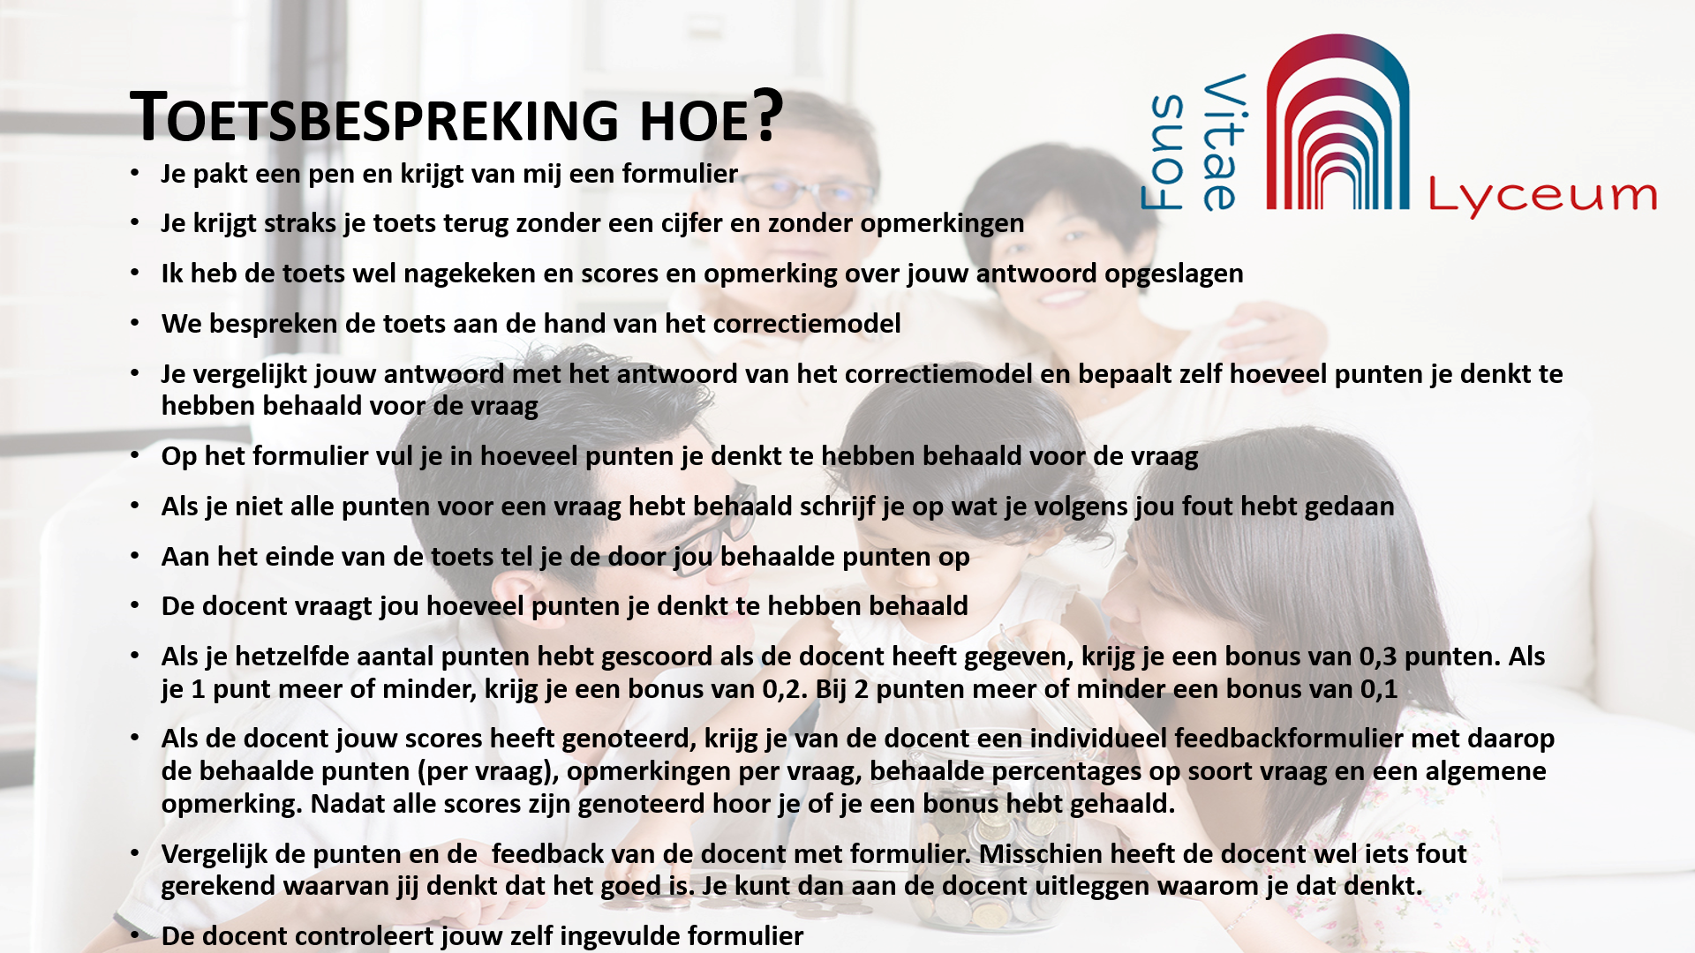
My experiences
Students want to have a more clear idea about the answer
Most students really participate
  Lisa said: If I had knew I had a grade this high, I would not have participated
Student do not come begging for points, but ask why
Gap between small and big tests decrease by 0.5 – 0.7 (average)
Always an extended test analyse
Help the use the feedback the next time.
  Promising things will be back and they will be rewarded for using the feedback
Solid instruction is important

Slide 22


